Slide 1
R versus Excel/VBA
Karen Seidel & Tom Taverner

Slide 2
Contents
Capital modelling workflow
Typical challenges
On the input side
On the output side
Issues with typical Excel/VBA systems
Improved systems setup
Analysis & Reporting Tool

Slide 3
Capital modelling Workflow – inputs
Data Owner
Data / Parameters
Combined model inputs
Premiums
Business Planning
Reserves
RI credit risk param.
Economic variables
Op risk param.
Asset dispositions
Accounts / Actuarial
Insurance risk param.
Actuarial
Risk mgmt / Actuarial
Rating agencies
Finance / Actuarial
Accounts
Capital model

Slide 4
Capital modelling - inputs
What are the main challenges on the input side?
Lots of different data sources and data source systems
Lots of data processing & data validation issues
Lots of different data versions
Team work
Notes:
Inputs - different versions
We produce new versions of data in many ways, some examples:,
replacing relevant csvs using extracts of the csvs from the CCK Data Platform when new versions of the data from the sources into CCK DP exist, to then create a new "latest base data" version of the inputs
making manual changes to the appropriate csvs (can be any inputs)
creating a new version of the (complete set of) data by pulling some csvs from one past version of the complete set, some from another
making programmatic changes
modifying datasets within some csvs using Excel, and then being careful to output correctly to match the appropriate formatted required by the CCK.
any combination of the above that produces a valid set of input csv files.

Slide 5
Capital modelling workflow - outputs
Stakeholders
Capital model
Reporting
- Capital requirem’t
- Other risk metrics
- Prob. distributions
- Sensitivities
- Risk allocation
- What-if analyses
…
Chief Actuary
Board / senior management
Risk management
Regulatory authority
Rating agencies
Model outputs

Slide 6
Capital modelling - outputs
What are the main challenges on the output side?
Very high data volumes (Terabytes)
Lots of model runs with different versions of data and model configurations (> 1000 in one year)
Audit trail from input & model configuration to output
Lots of different analyses and reports
Team work

Slide 7
Capital modelling Typical systems setup
Data sources: Various Systems
Combined input data: Excel / VBA
Capital Model: Igloo / Remetrica
Reporting: Excel / VBA
Model outputs: Excel / VBA

Slide 8
Issues with Excel / VBA
Disparate data sources ⇒ lots of linked files
Updating links in Excel is haphazard
Updated at different times / lots of different versions
Links do not automatically point to new file versions
Version numbers in filenames break links
Tracking links becomes impossible
Problems with referential integrity
Eg business planning segmentation of business is different from underwriting classes of business
Lots of lookup functions – very hard to check

Slide 9
More Issues with Excel/VBA
Most common update is moving forward one year
Means changing layout of tables
Affects references to ranges
Potentially makes links obsolete
No support for team work / multi user environment
Only one user can work on a file at any given time.
Standard solution is to split files ⇒ more links
Or make copies ⇒ problems with combining changes made by different users on different copies.

Slide 10
ISSUES with VBA
VBA and data are typically bound together (although it is possible to have files which only contain VBA and operate on other files)
VBA Code is duplicated many times over, because a copy is made every time the data is updated and a new version created
VBA Code changes cannot easily be applied to past data sets
Software development standards are hard to enforce
No formal version control
No concept of code releases
No concept of deployment
No way of going back to earlier releases
…

Slide 11
LIMITations of Excel reporting
Can’t handle high data volumes
Disconnect between input data and model outputs – lack of audit trail
Notes:
Excel 2010 is limited to just over 1m rows, though performance really suffers if you try to use that many for further calculations. R is only limited by the memory of the PC you use. For an example I have just read in a dataset from our model which has 212m rows in seconds and we can easily perform analysis on datasets that size.
In addition, we use an R package called ‘ff’ to analyse datasets that are too big to fit into memory. For instance, we have member data with 830m rows, which we can analyse with this method. It uses the hard drive instead of the PCs memory, so there is a performance hit. Data sizes are essentially limitless using this method – just a question of disk space and runtime.

Slide 12
Disadvantages of R
Typical business users don’t use it
Not suited to disseminating model results to stakeholders

Slide 13
Capital modelling improved systems setup
Data sources: Various Systems
Combined input data: Excel / R / version control for data & code
Capital Model: Igloo / Remetrica
Reporting: Excel / R / version control for reports & code
Model outputs: Excel / R

Slide 14
Objectives of Analysis & Reporting tool
Standardise reporting process for analysts
Share analyses between analysts
Make model results accessible to non-analysts
Produce high quality reports
Speed up report generation

Slide 15
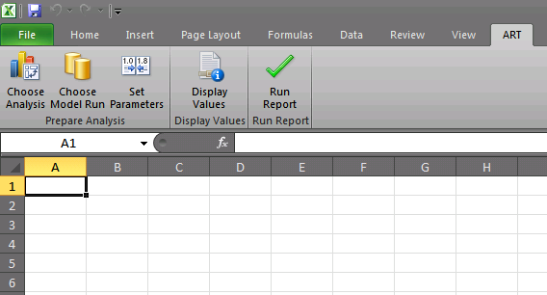
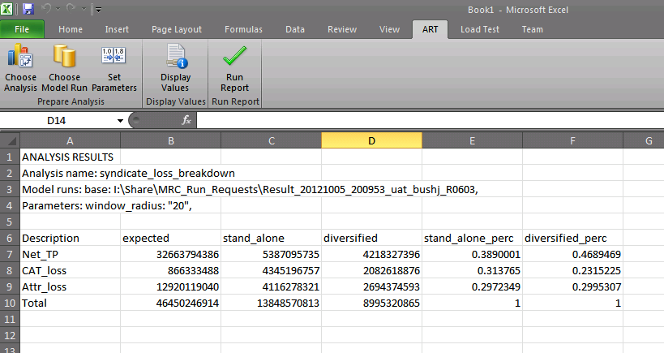
Reporting Process with ART: Excel Addin
Analyses defined in R can be imported into Excel

Slide 16
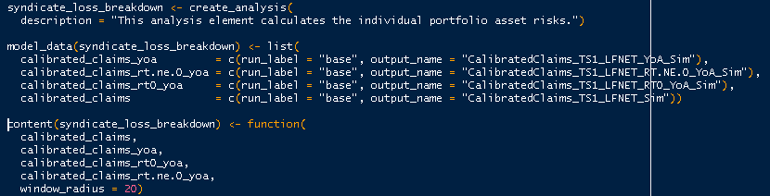
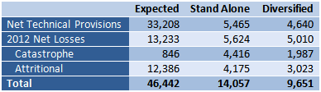
Reporting Process with ART: Report Elements
Report elements combine an analysis with a method of presentation
Specify the analysis
Select or specify presentation format

Slide 17
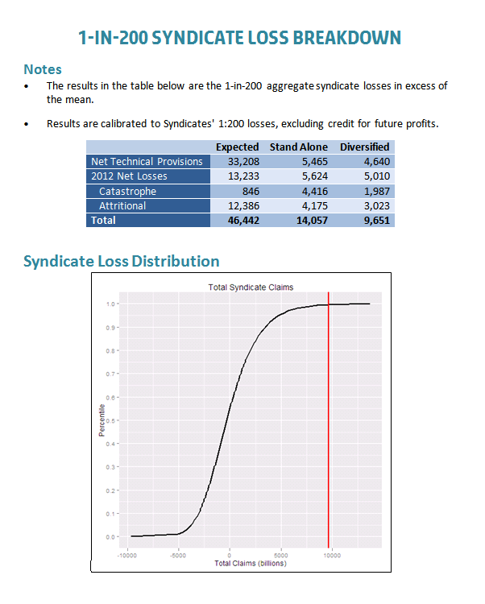
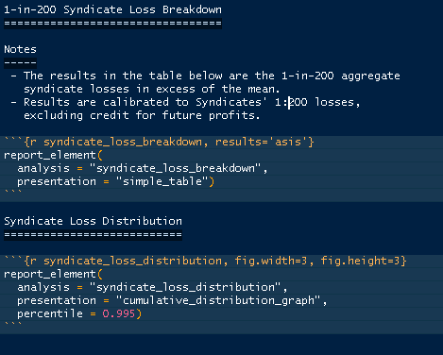
Reporting Process with ART: Reports
Define report by combining report elements
Generate report
based on model run(s)

Slide 18
ART Benefits
Increased confidence in analysis results and reports
Reproducible and consistent reports
Improved access and visibility of CCK model data
Increased focus on analysis
Extensible by end users (actuaries) via a flexible framework

